Slide 1

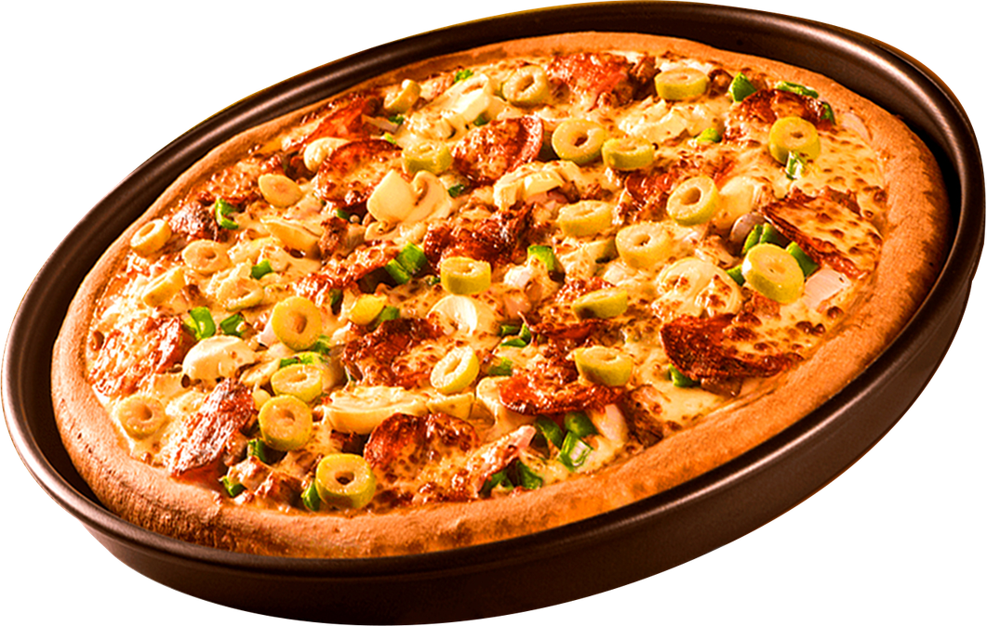
PIZZA
SALES

Slide 2



INGOUDE COMPANY
ABOUT ME
I am Vibhav K. Pandey, a recent postgraduate in statistics. During my master's, I developed a keen interest in data and allied fields. I also got 5th rank in my university.
I love to play with data and draw meaningful insights from it .

Slide 3

Project details
In this project, we have data related to the sales of pizzas in the form of CSV files. By loading those files in SQL and performing various operations (like joins and group), we tried to solve problems related to sales.

Slide 4

Retrieve the total number of orders placed

Slide 5
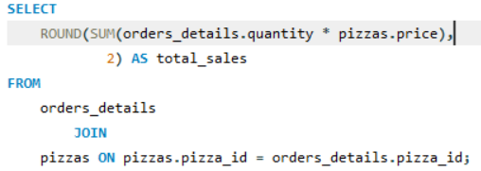
Calculate the total revenue generated from pizza sales

Slide 6
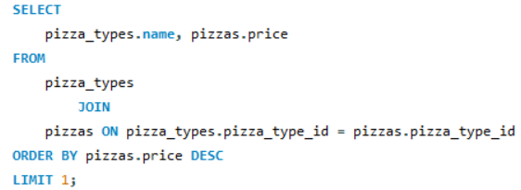
Identify the highest-priced pizza

Slide 7
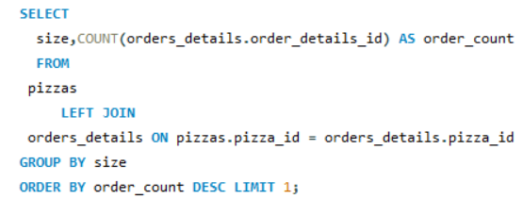
Identify the most common pizza size ordered

Slide 8
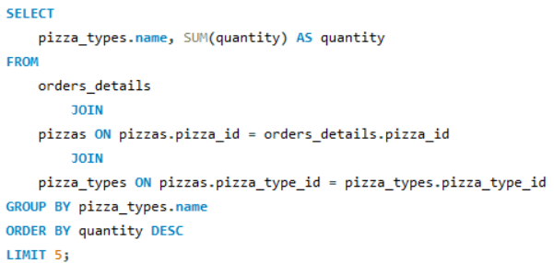
List the top 5 most ordered pizza types along with their quantities.

Slide 9
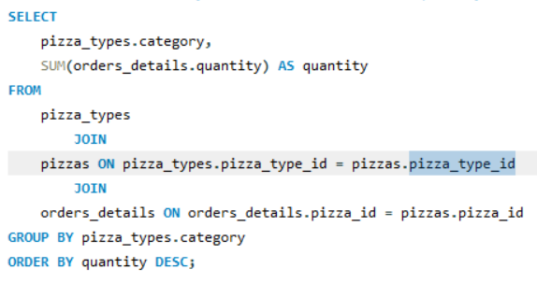
Join the necessary tables to find the total quantity of each pizza category ordered.

Slide 10
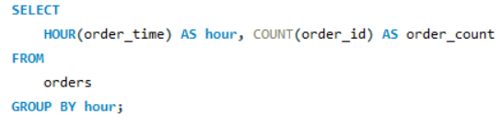
Determine the distribution of orders by hour of the day

Slide 11

Join relevant tables to find the category-wise distribution of pizzas

Slide 12
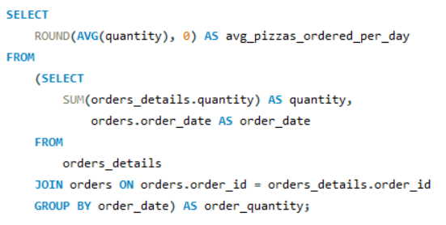
Group the orders by date and calculate the average number of pizzas ordered per day

Slide 13
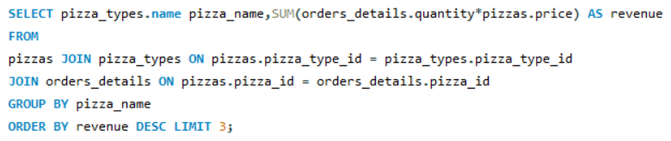
Determine the top 3 most ordered pizza types based on revenue.

Slide 14
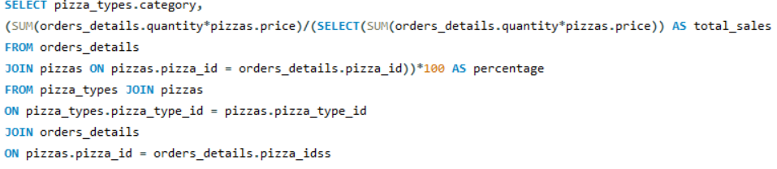
Calculate the percentage contribution of each pizza type to total revenue

Slide 15
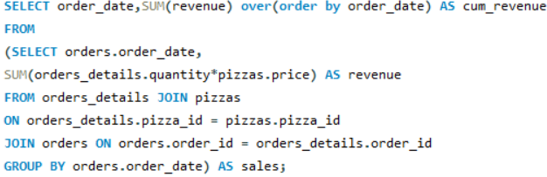
Analyze the cumulative revenue generated over time

Slide 16
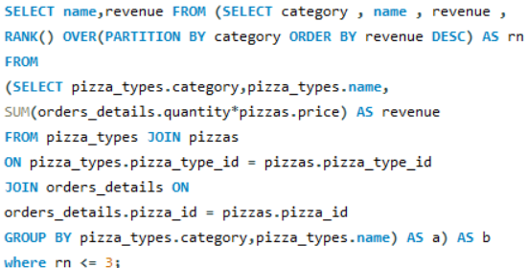
Determine the top 3 most ordered pizza types based on revenue for each pizza category

Slide 17

Thank You

